Slide 1

Bioinformatics
Final presentation
Data Analysis Final Presentation
Drug repurposing – gastric cancer
Summer term 2023
19.07.2023
Project 05 - Group 01
Supervisor: Prof. Dr. Carl Herrmann
Tutor: Ana Luisa Costa
Presenting: Deniz Korkmazel, Evgeniya Abadzhieva, Hanna Frieß, María Paula Fuentes
Deniz Korkmazel, Hanna Friess,
Evgeniya Abadzhieva, Maria Paula Fuentes

Slide 2
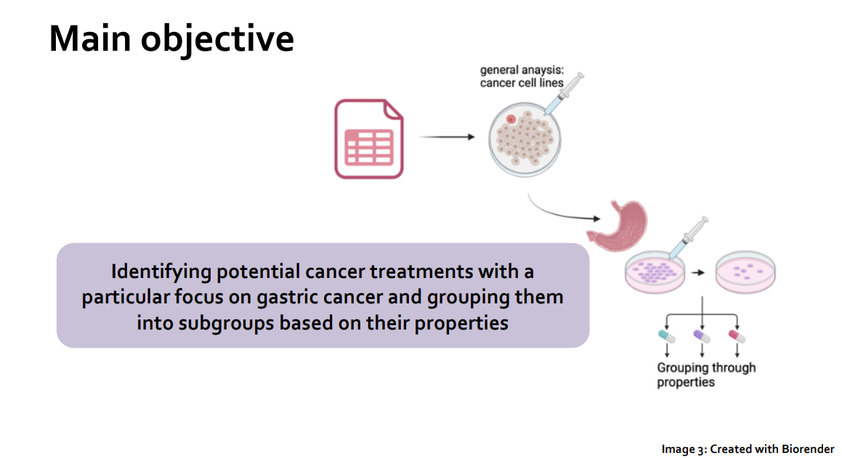
A little reminder:

Slide 3
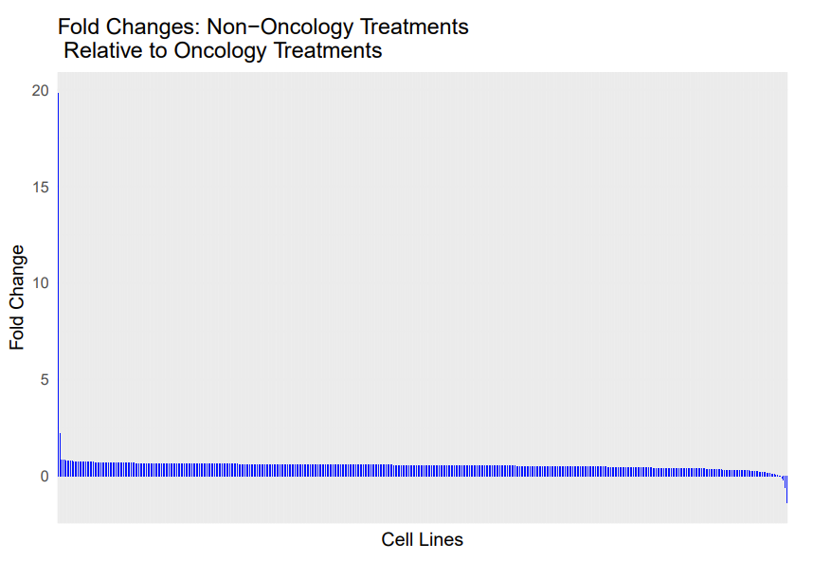
Fold change analysis: general analysis

Slide 4
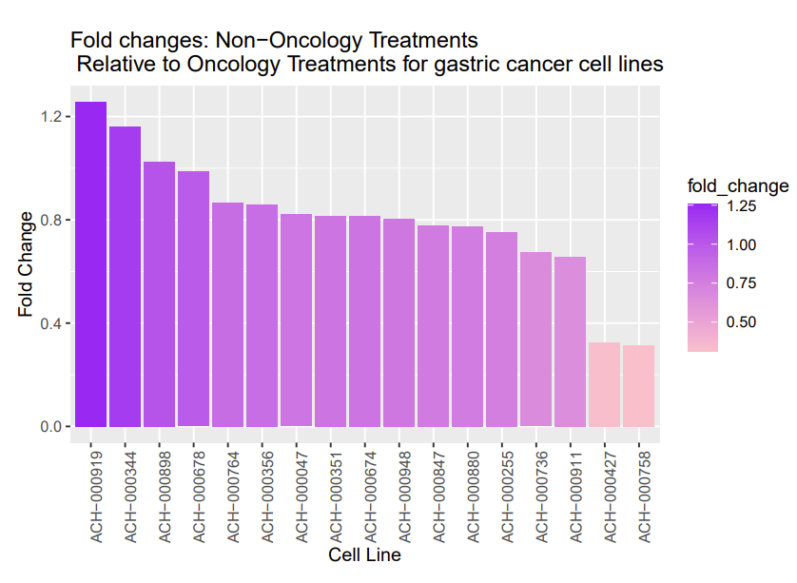

Slide 5
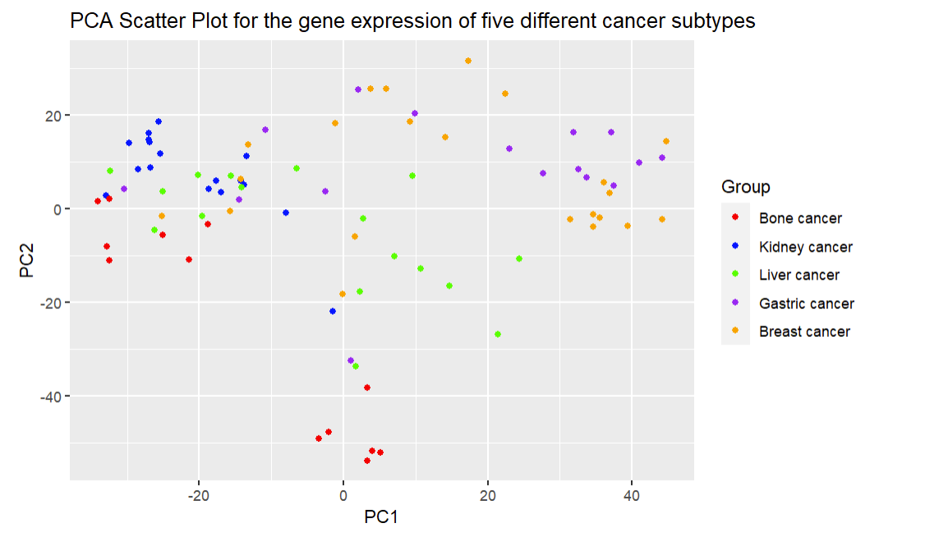

Slide 6
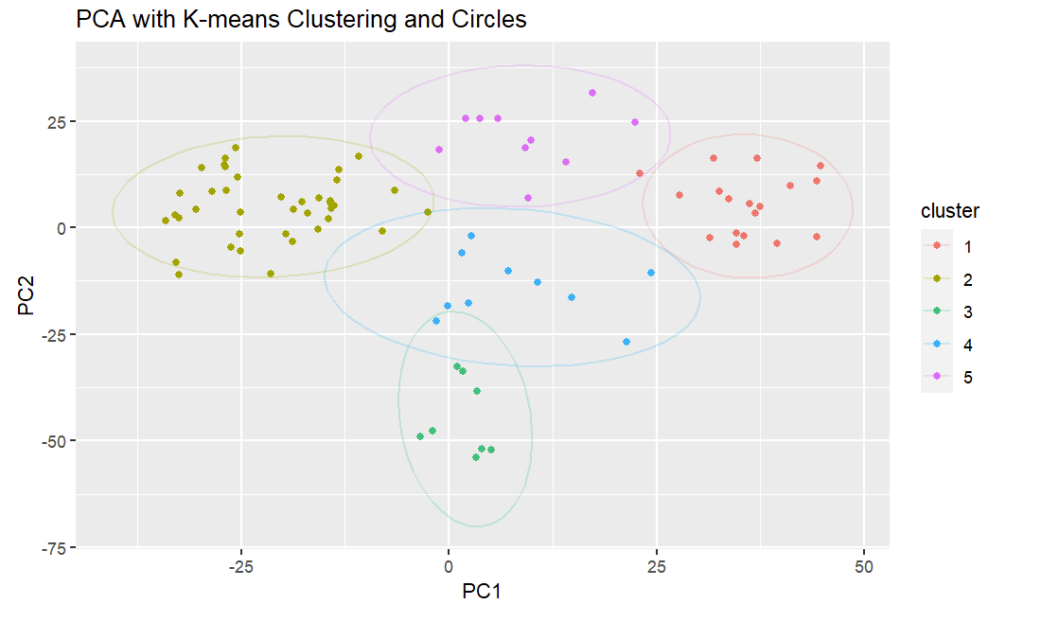
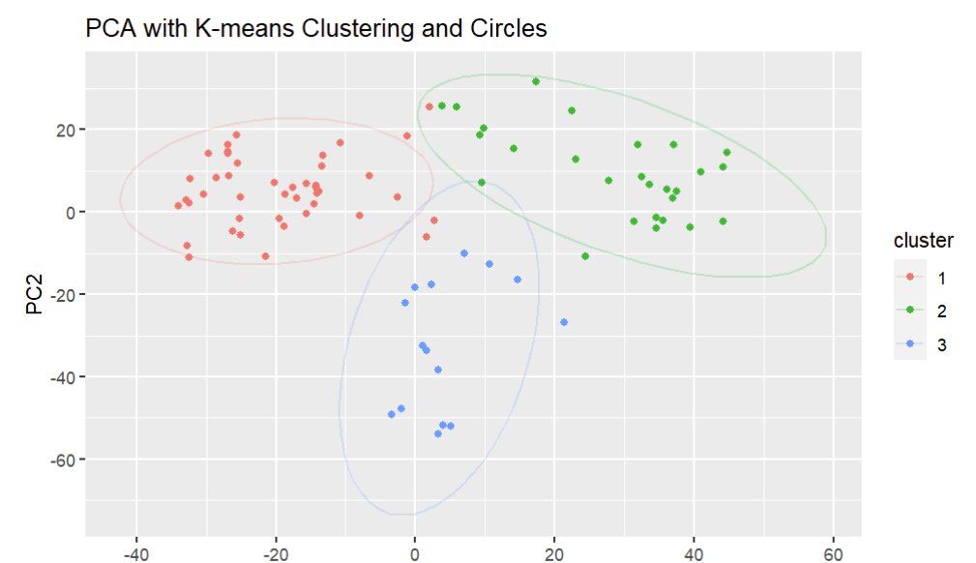
Comparing different amount of centers for K-Means clustering

Slide 7
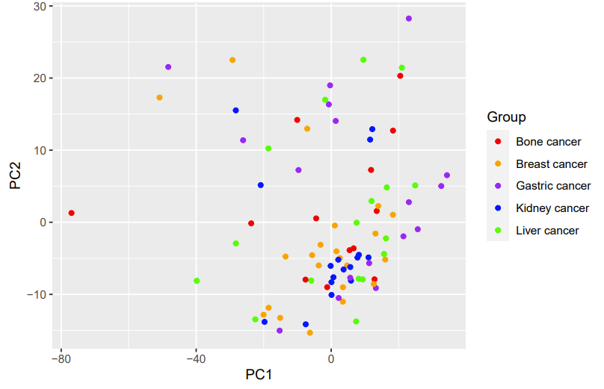
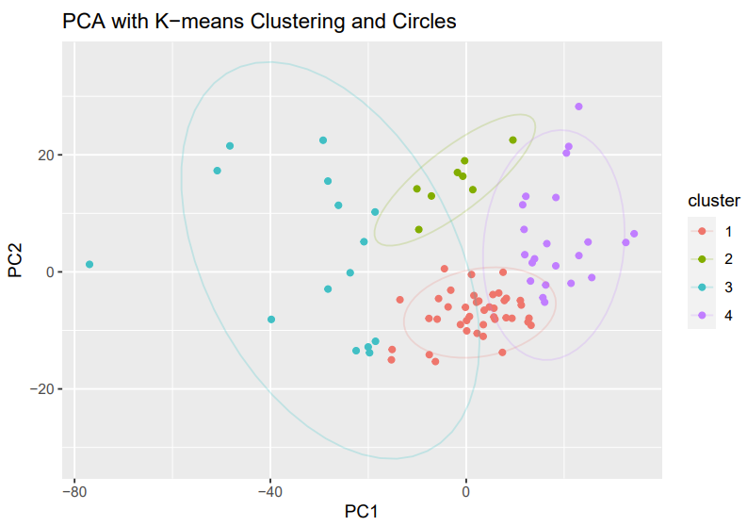
PCA for drug response of five different cancer subtypes

Slide 8
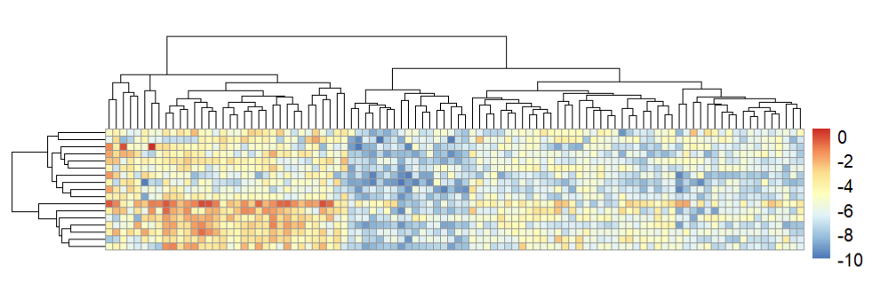
Throwback to the project proposal

Slide 9
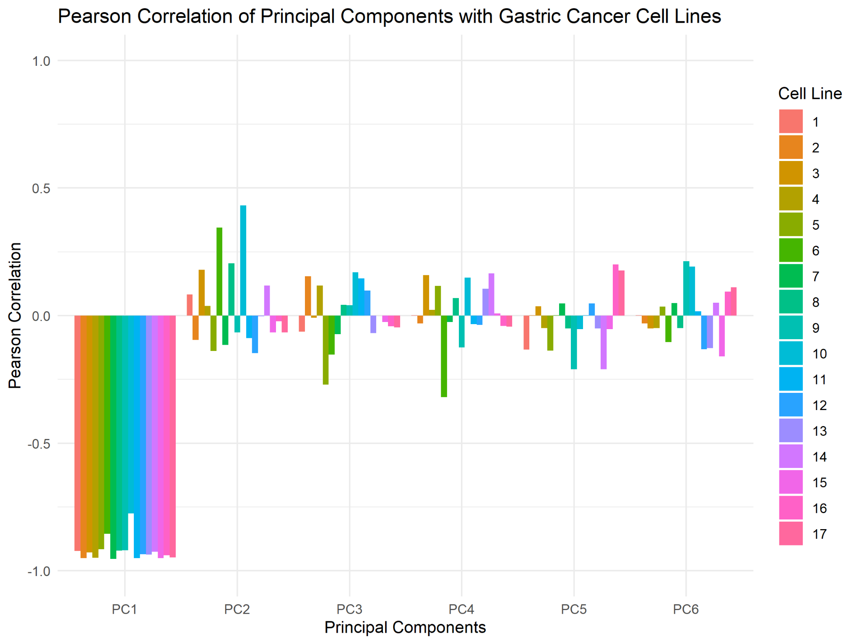
Data reduction - PCA
Identifying drugs inducing strong negative cell growth

Slide 10
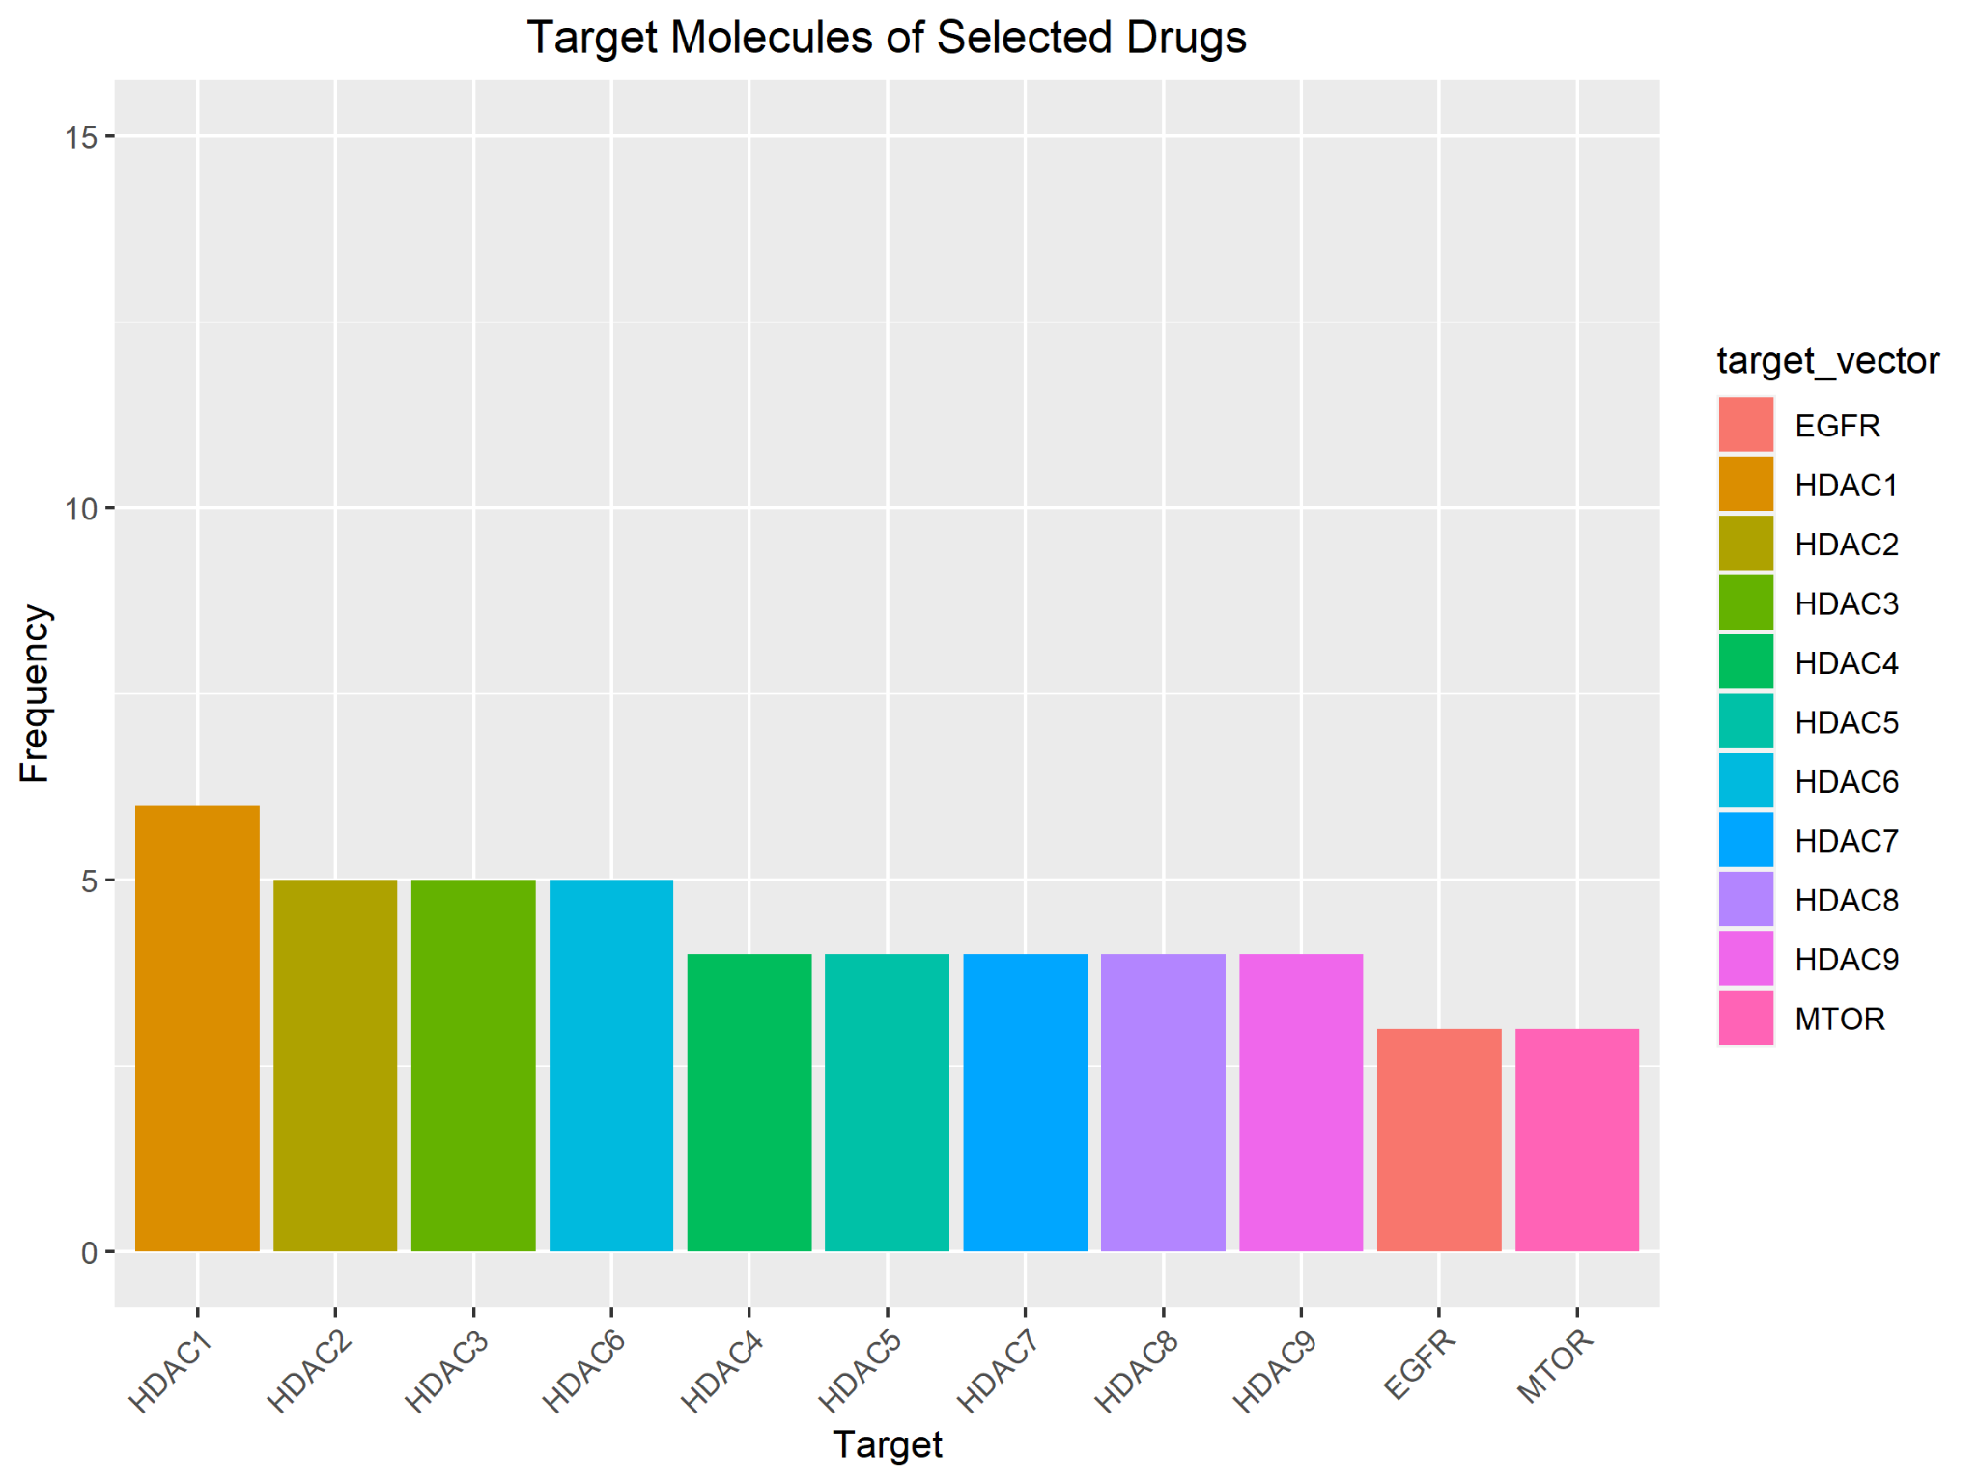
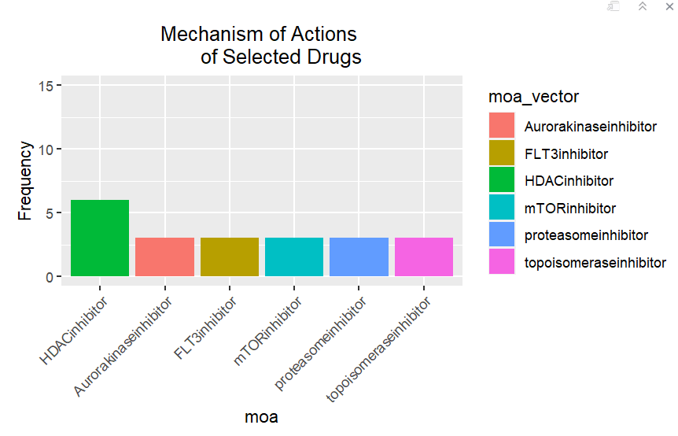
Identifying top targets and mechanism of actions

Slide 11
HDAC inhibitors
Disease
General info
Oncological drugs

Slide 12
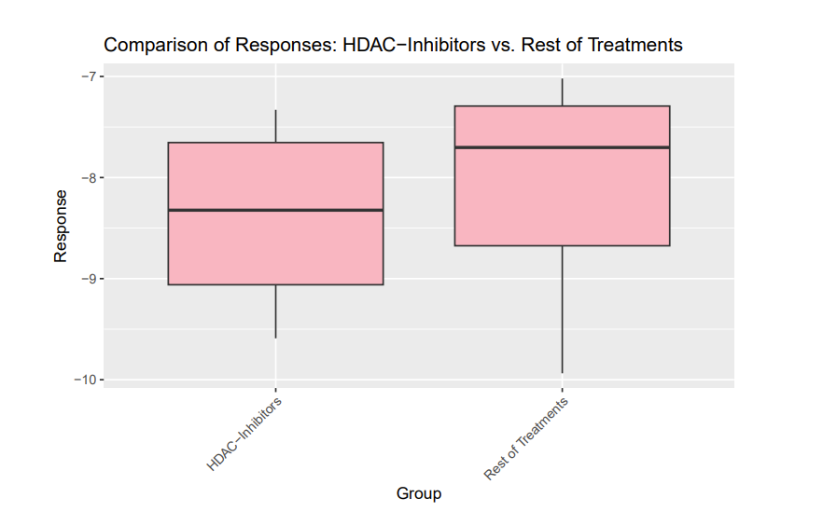

Slide 13
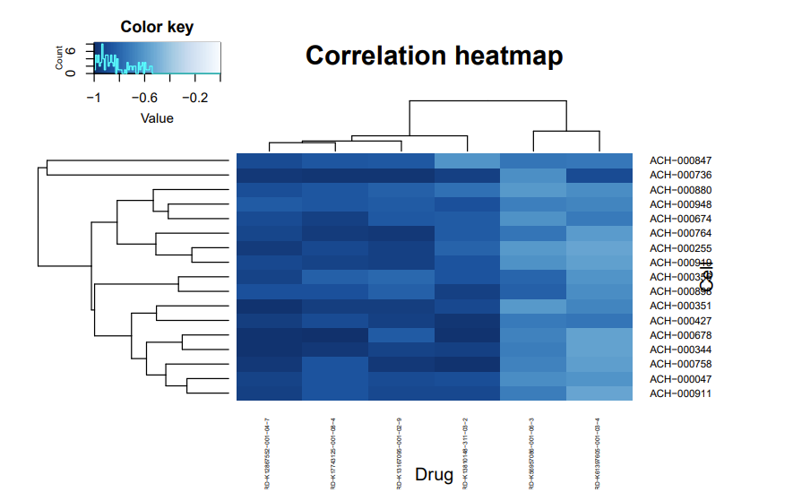
Drug concentration

Slide 14
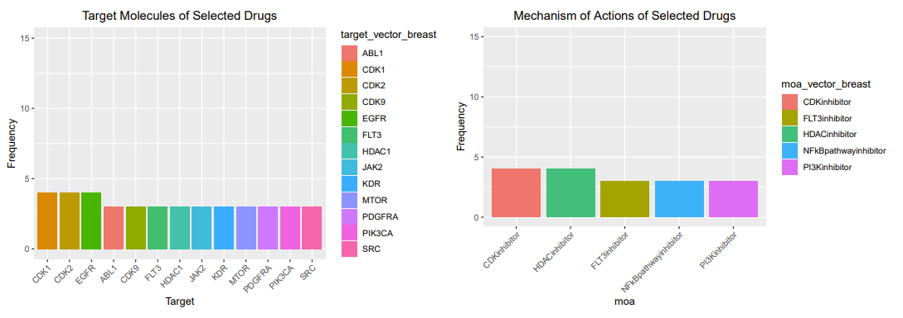
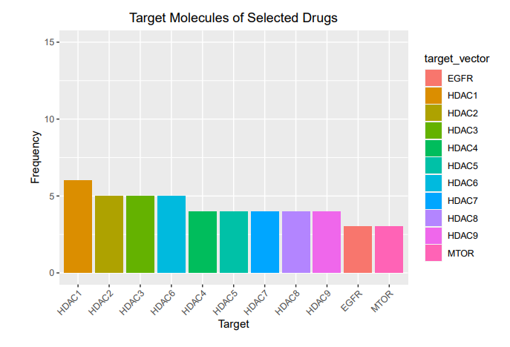
Comparative Analysis: Shared Targets and Mechanisms of Action in Gastric and Breast Cancer

Slide 15
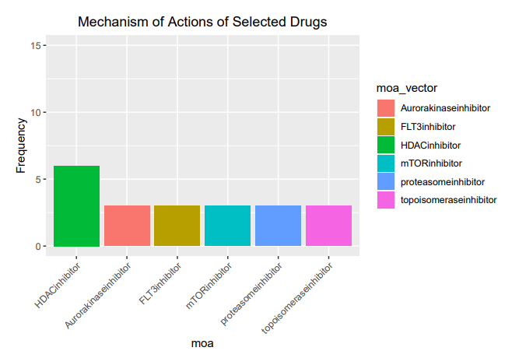
Comparative Analysis: Shared Targets and Mechanisms of Action in Gastric and Breast Cancer

Slide 16
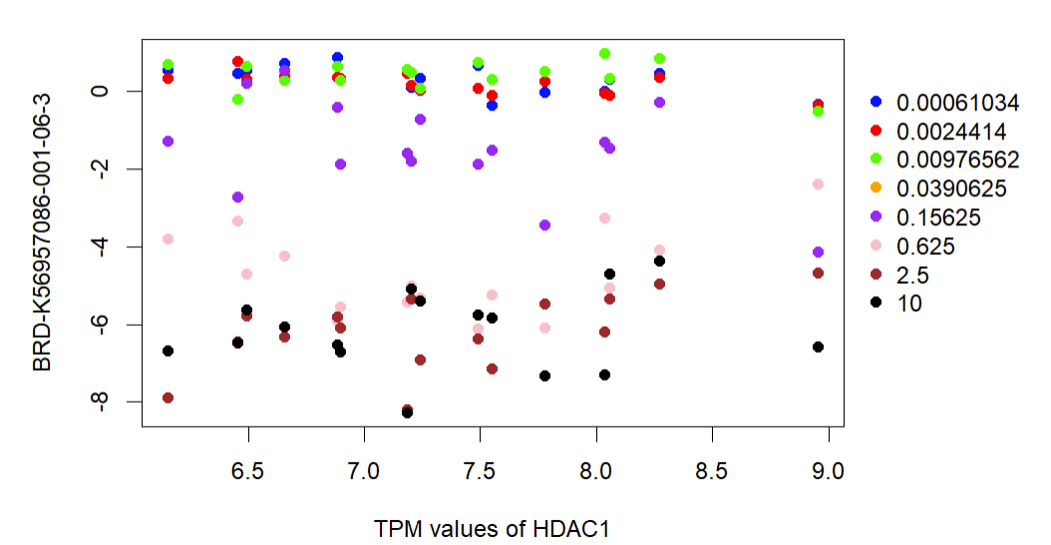
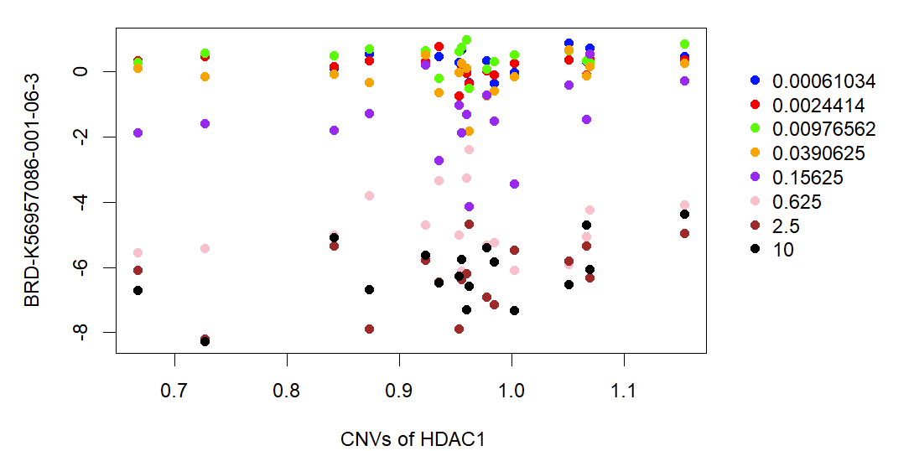

Slide 17
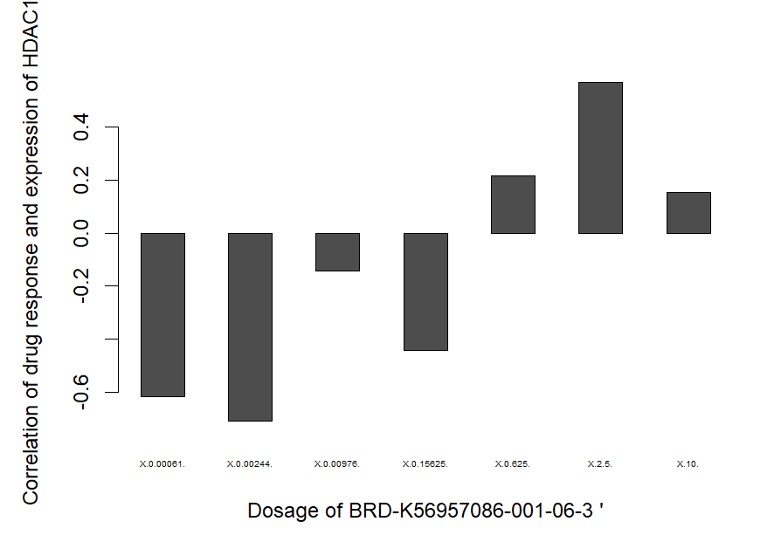
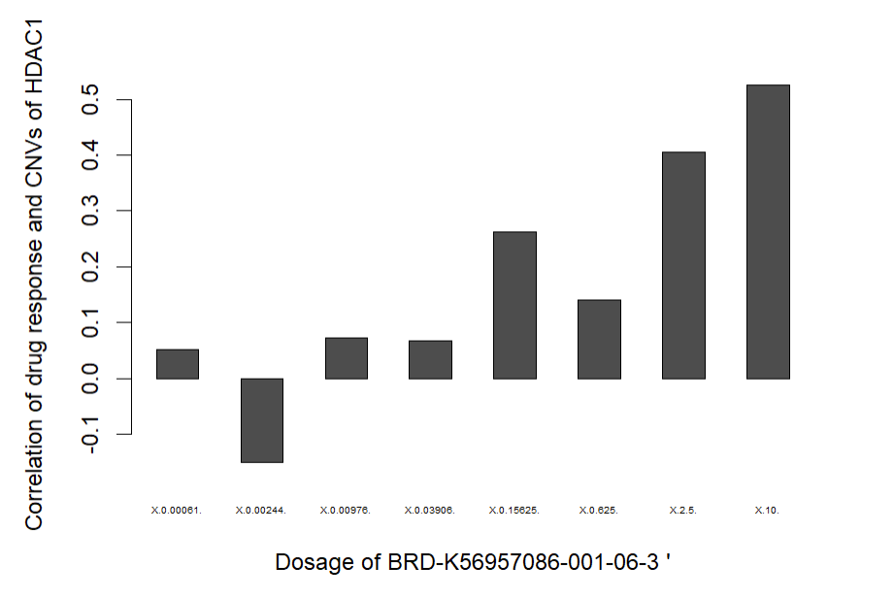

Slide 18
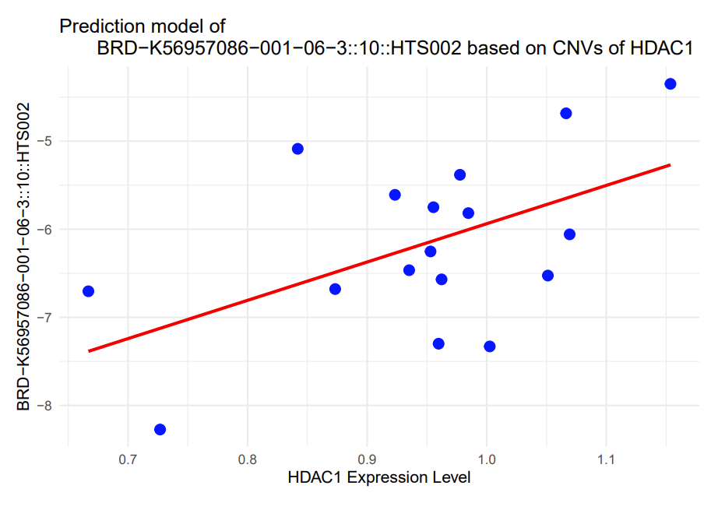
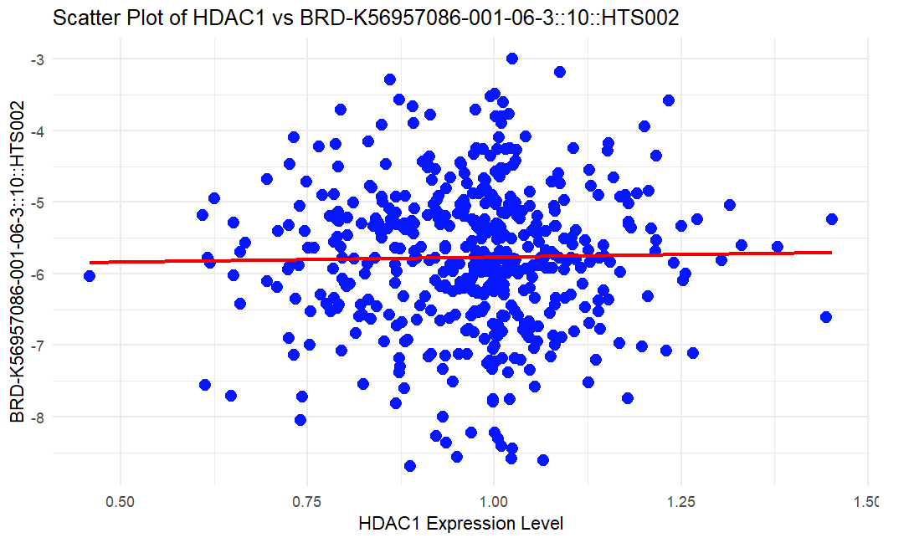
Linear Regression

Slide 19
Core message of our analysis
HDAC Inhibitors
Proofs
Paper for future research

Slide 20
FURTHER ANALYSIS

Slide 21
References for further research

Slide 22
Extra Slides

Slide 23
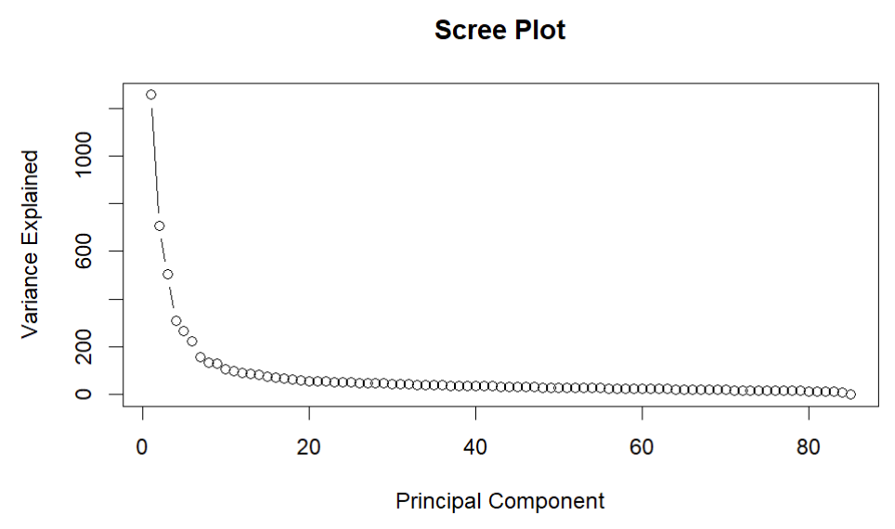

Slide 24
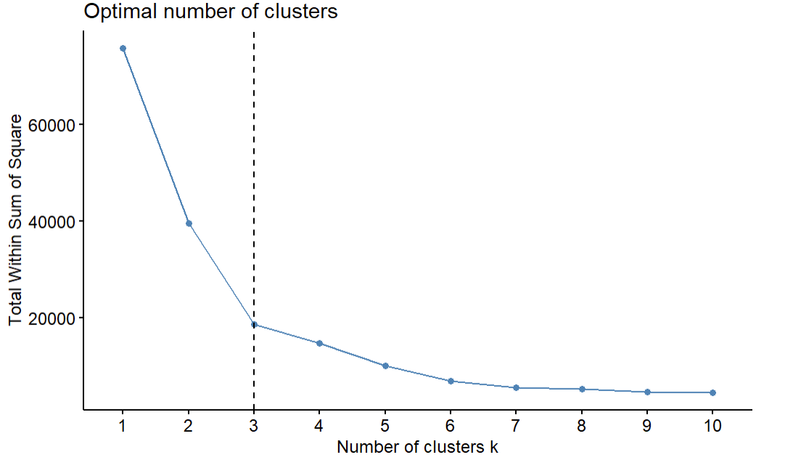

Slide 25
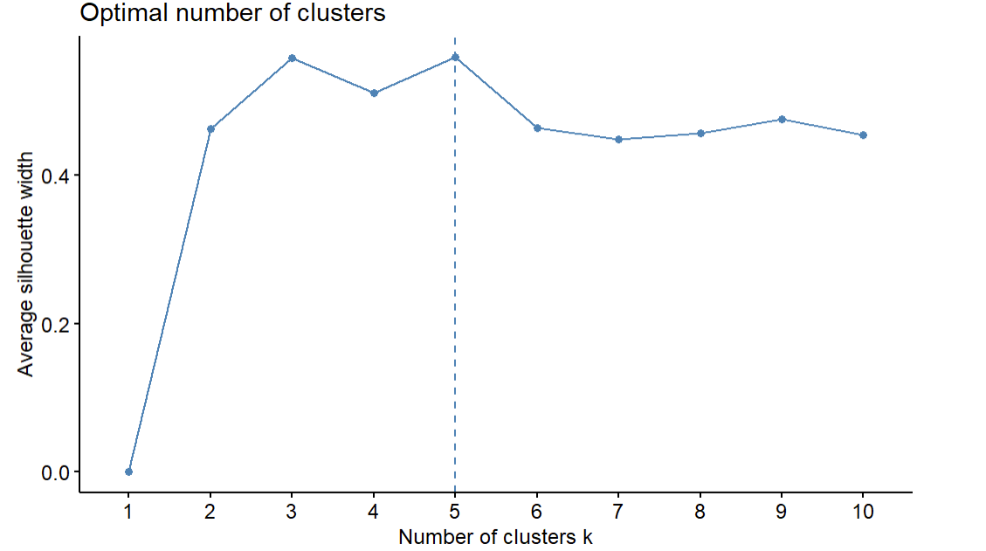

Slide 26
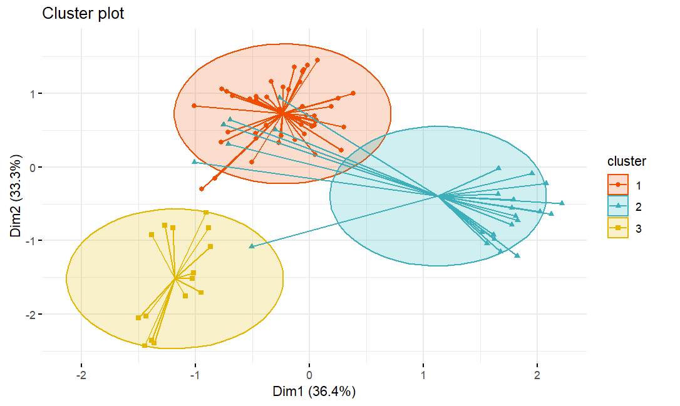
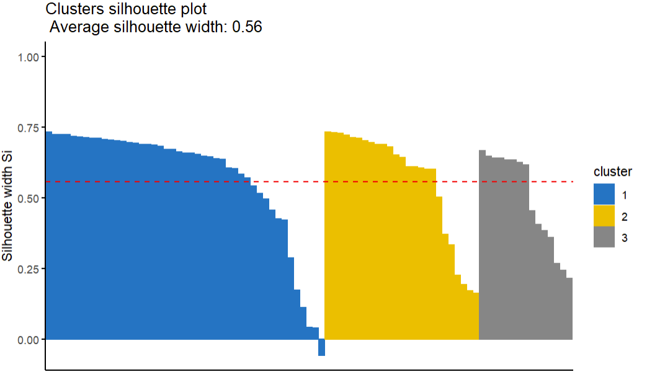

Slide 27
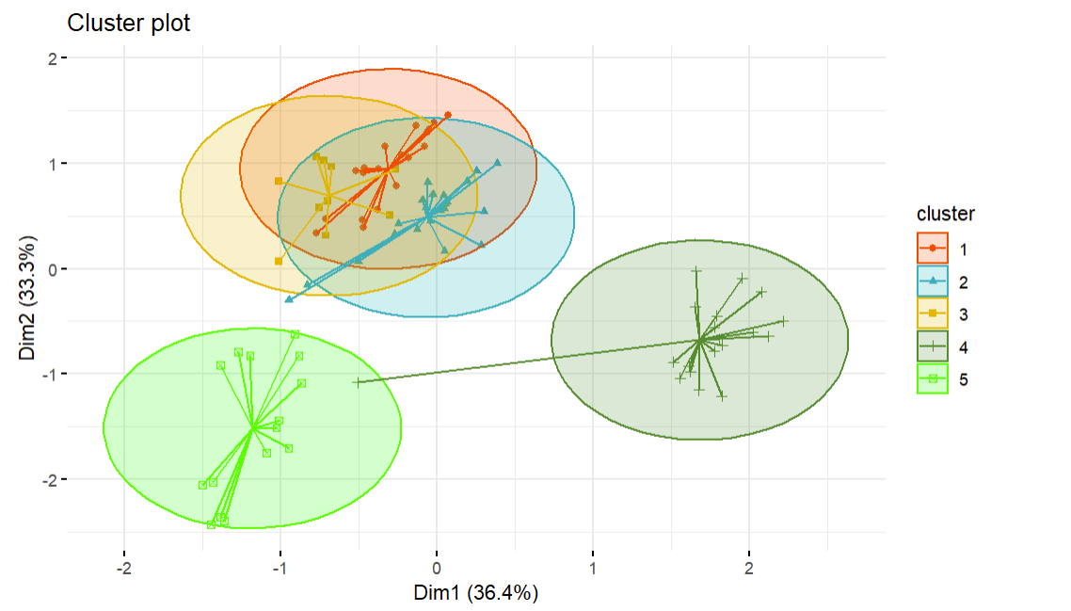
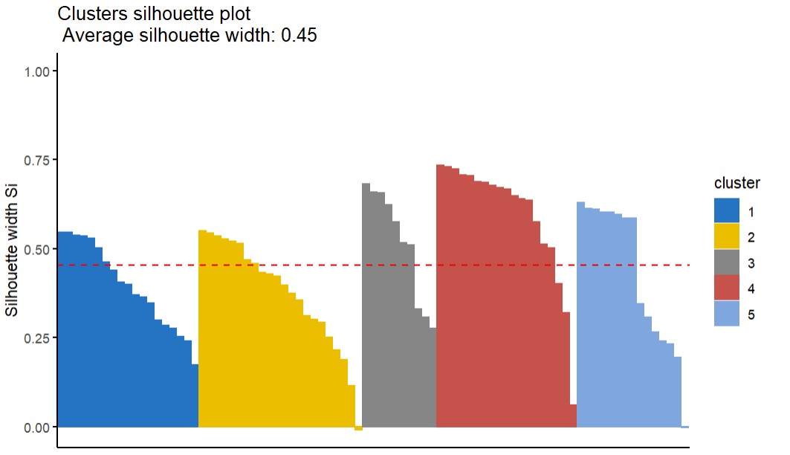

Slide 28
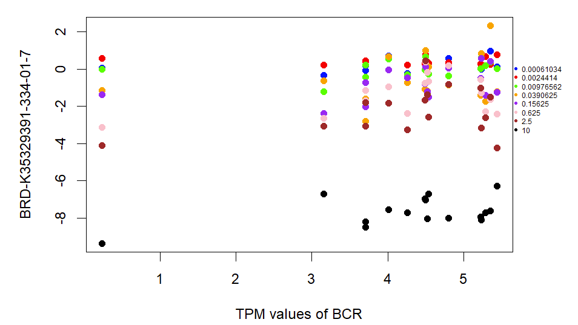
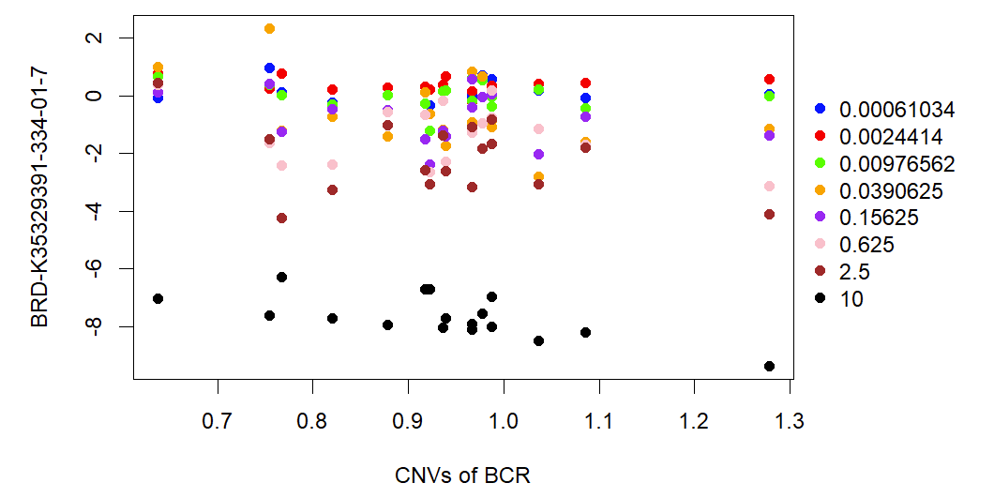

Slide 29
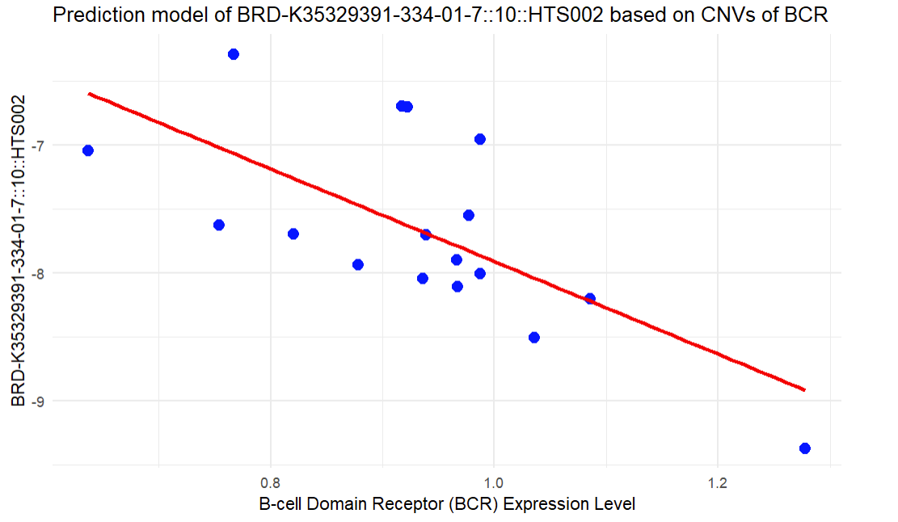

Slide 30
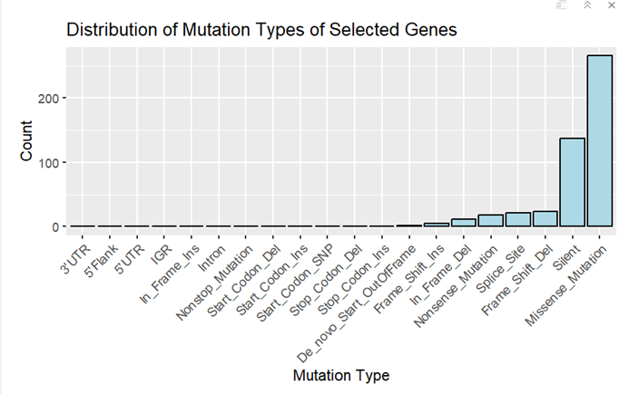
Mutation

